Slide 1
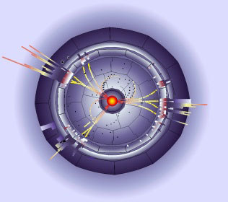




Particle Physics
Tutorial
Thomas Lohse
Schule für Astroteilchenphysik 2016
Universität Erlangen-Nürnberg

Slide 2
Problem 1: LHC at
Two gluons (of the incoming protons) collide head-on. Each carries 10% of the momentum of its proton. Compute the cm energy of the two gluons.
The gluons are scattered by an angle . Compute q², the square of the four-momentum transfer.
Compute the spatial resolution reached in this scattering process. Note:
A proton of one of the LHC beams hits a proton inside a gas molecule left in the (highly evacuated) beam pipe. Compute the cm energy for this collision.

Slide 3
Problem 2: Future circular collider?
The LHC has a circumference of 27 km. With the current superconducting magnets it can reach a maximum cm energy (proton-proton) of 14 TeV with 3×10¹⁴ protons per beam.
Consider a future LHC-like machine with a cm energy of 100 TeV. Assume that by aggressive R&D one can double the field of the magnets. Find the circumference of the ring.
The synchrotron radiation power of one LHC beam (at design) is 6 kW. What would be the corresponding power for the new machine assuming the same number of particles per length?
Consider now an electron-positron collider in the same tunnel, able to produce top-quark pairs (cm energy 350 GeV). Compute the synchrotron radiation power if 100 bunches, each with 10¹¹ particles are stored per beam.

Slide 4
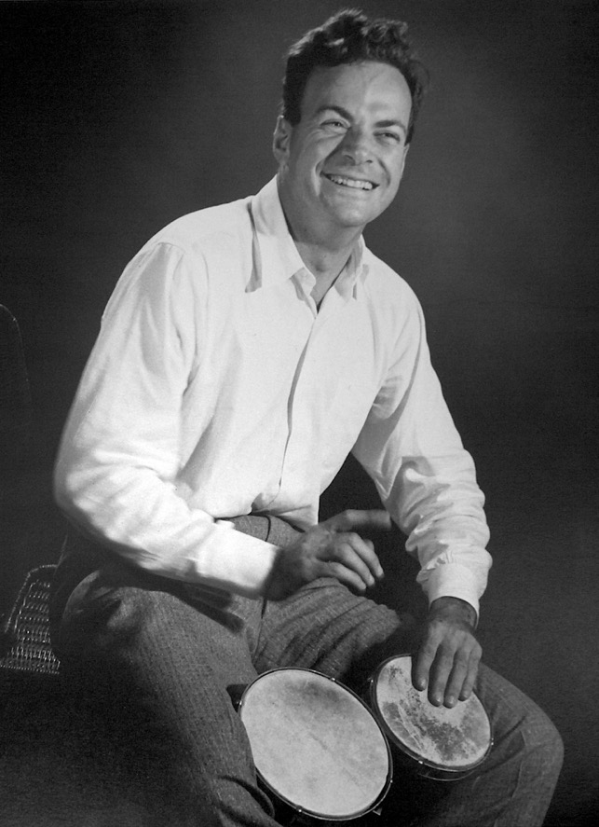
Problem 3: What is the correct pronunciation of:
Richard P. Feynman

Slide 5
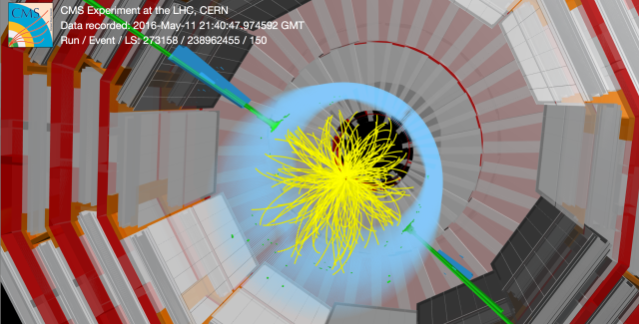
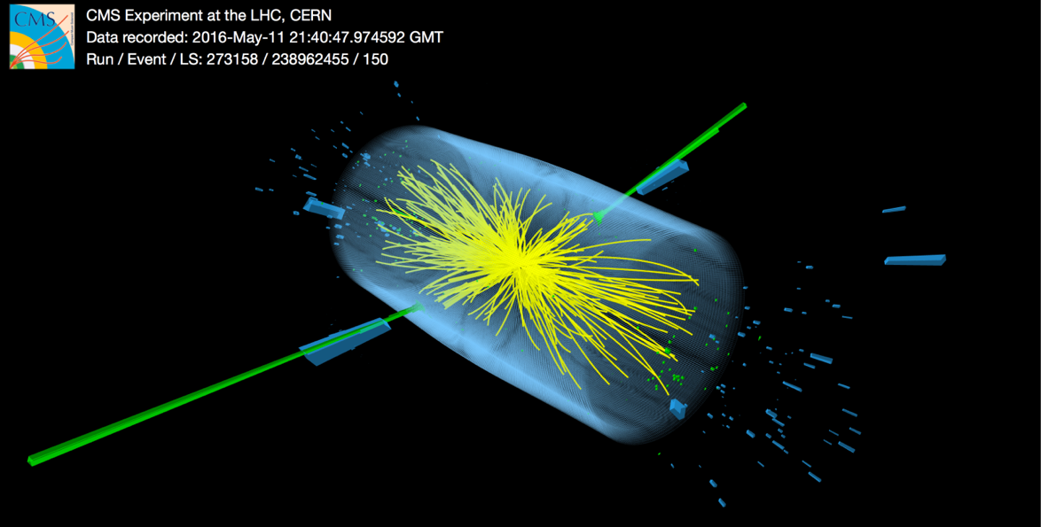
Problem 4: Event quizz
Look at the following event displays and identify final state objects. Can you imagine which process could have taken place? If possible, draw a Feynman diagram.

Slide 6
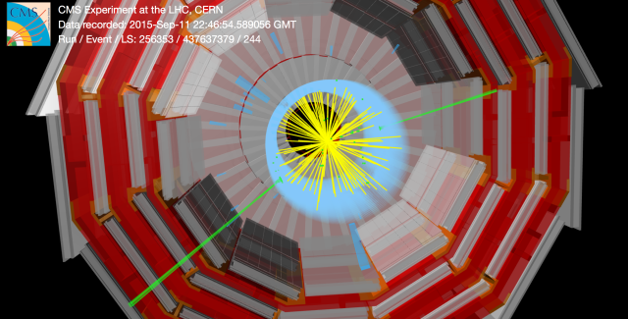
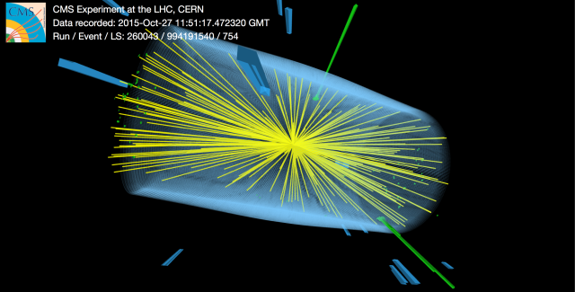

Slide 7
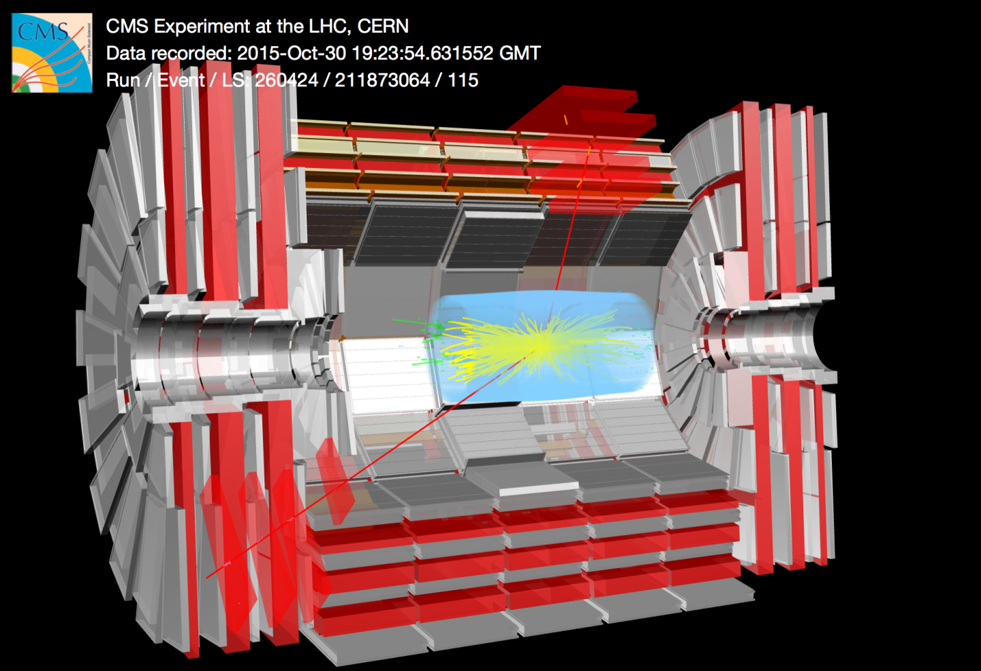

Slide 8
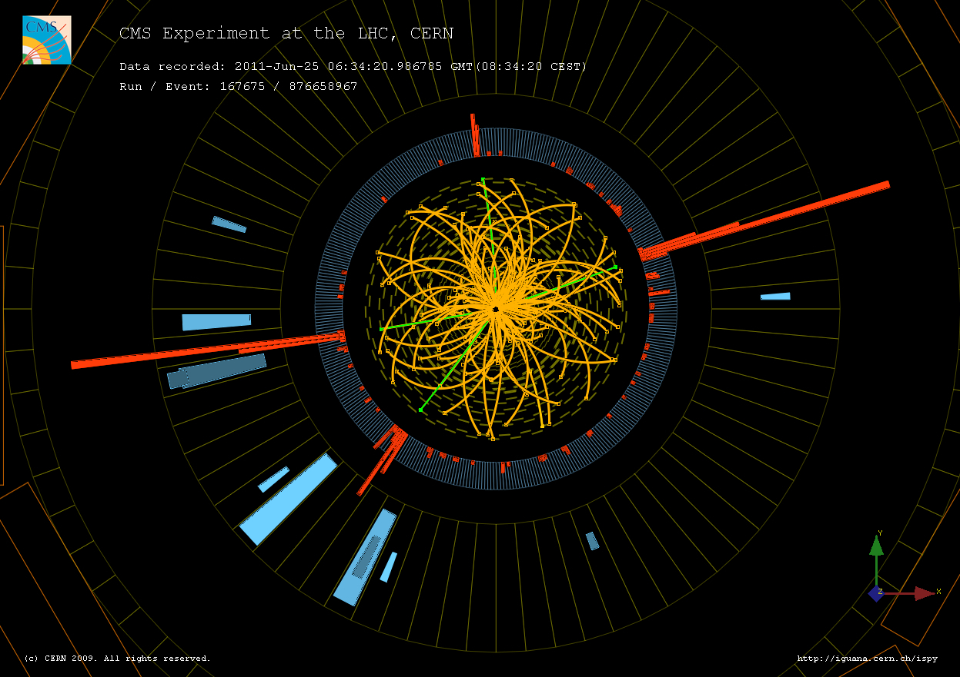

Slide 9
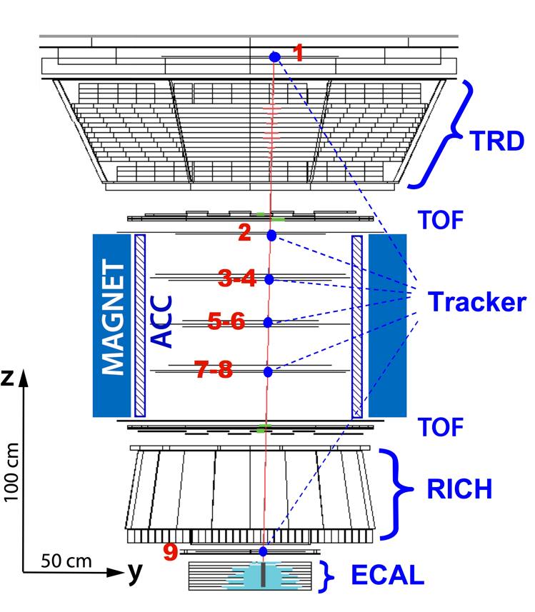
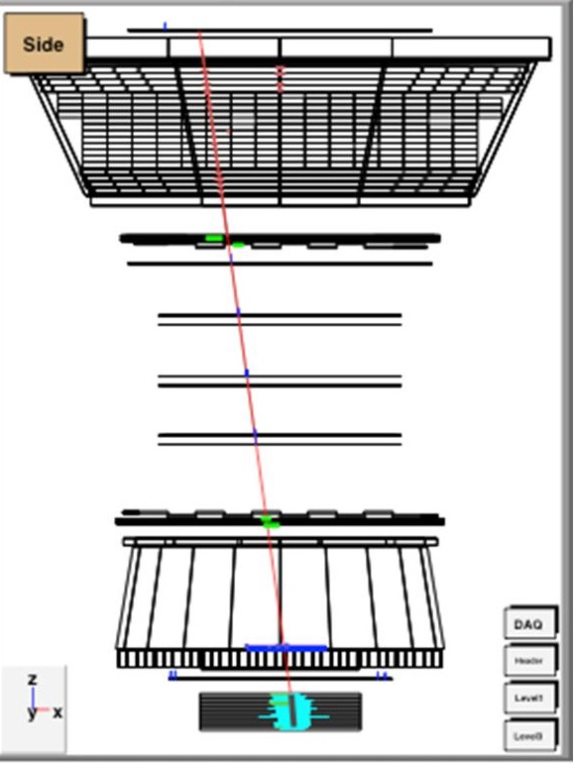
entrance window

Slide 10
Problem 6: Fill all charge numbers (if applicable) into the following table.
particle
colored? y/n

Slide 11
Problem 7: WW scattering
In the lecture we discussed all diagrams (of leading order) contributing to the process:
Draw all leading order diagrams contributing to the related process:
Draw a diagram which shows, how this scattering could happen at the LHC in proton-proton collisions.

